Slide 1
Fit.ly Tech Data Analytics Report
Analyzing churn drivers for a subscription-based fitness app

Slide 2
Background & Goals
Customer churn has increased slowly over the last two quarters
Acquiring new customer is costly
Loss of subscribers puts pressure on Marketing & Product
Goal: Reduce customer churn
Identify customer churn drivers
Business focus on subscription plan types, customer support, and user engagement
Establish business metrics to monitor
Recommend business strategies to reduce churn

Slide 3
Data Information
account_info
customer_support
user_activity
customer_id
email
state
plan
plan_list_price
churn_status
ticket_time
user_id
channel
topic
resolution_time_hours
state
comments
event_time
user_id
event_type
Three datasets provided by the Product Manager and Engineering Lead
Information provided about 400 users, including associated customer support and user activity data
28.5% of the customer dataset is marked positive for churn
Validation revealed issues with mixed alpha-numeric content, inconsistent variables between datasets, and inconsistent categorical variables
Cleaning steps applied to obtain robust dataset ready for analysis

Slide 4
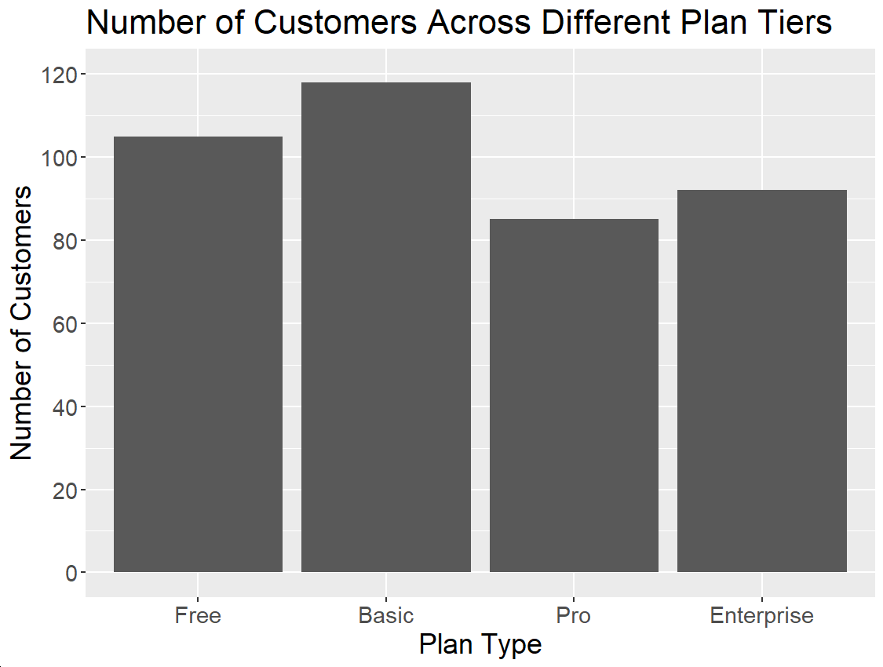
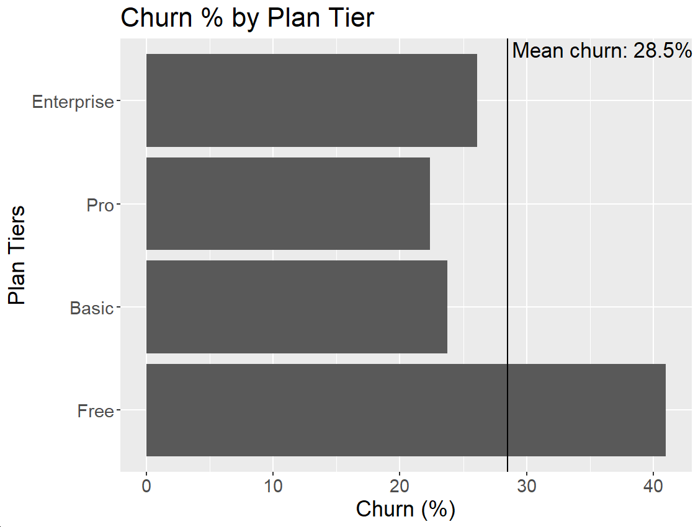
Users Plan Type Choices
All 4 plan tiers are popular choices for our customers
Churn rates differ between free and paid plans

Slide 5
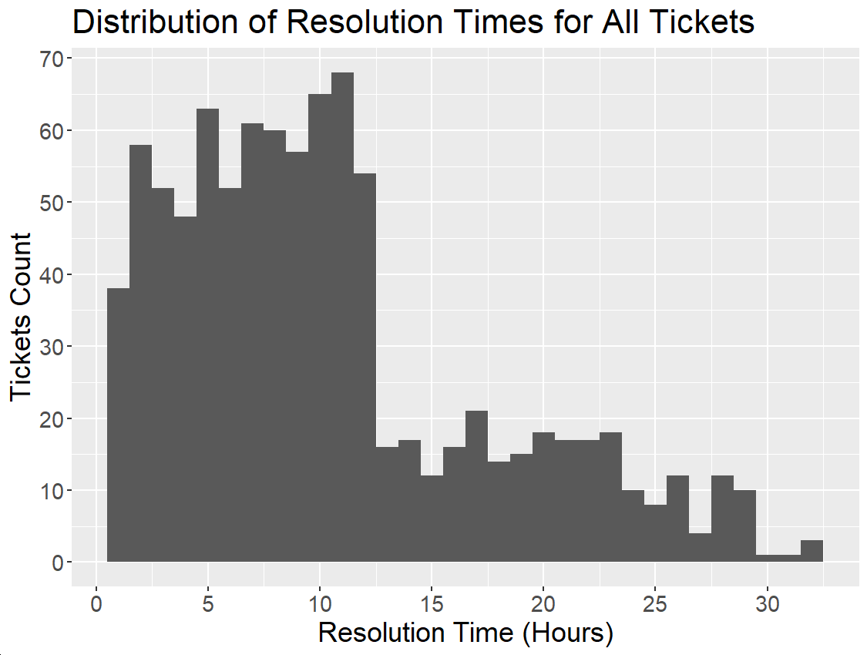
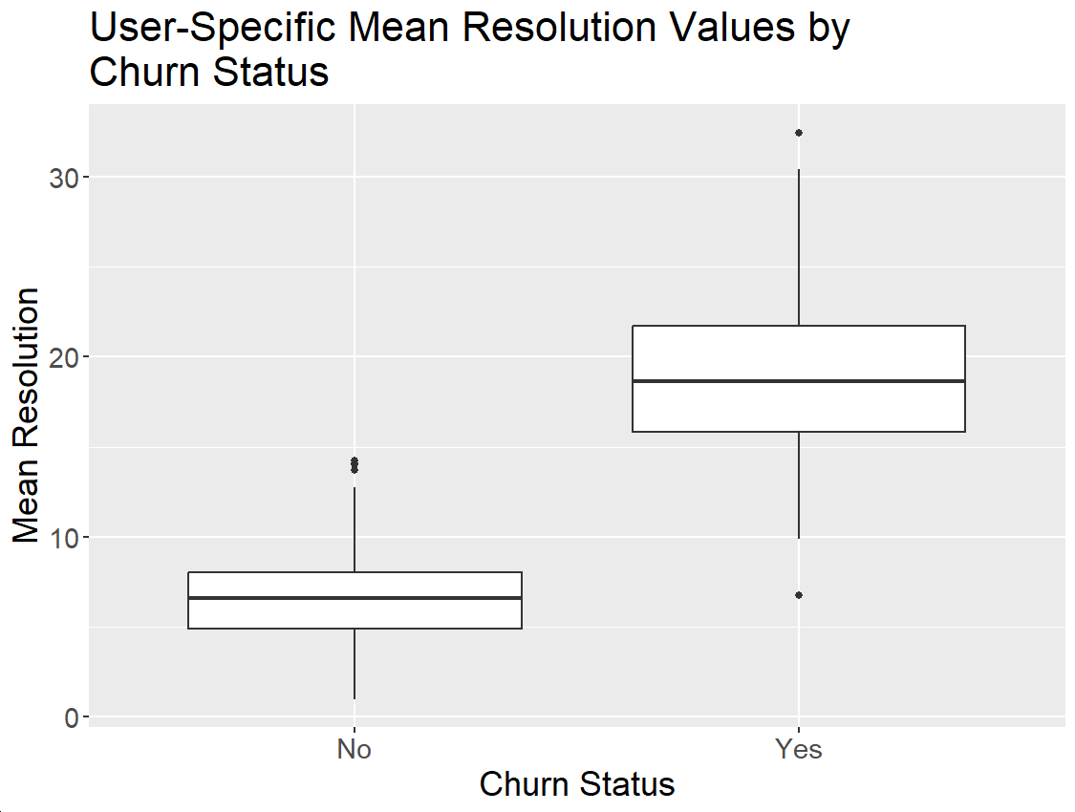
Customer Support Activity
Most tickets are solved within 12 hours (72.1%), but can take up to 32 hours to address
Users who have dropped their subscription are experiencing longer ticket resolution times on average

Slide 6
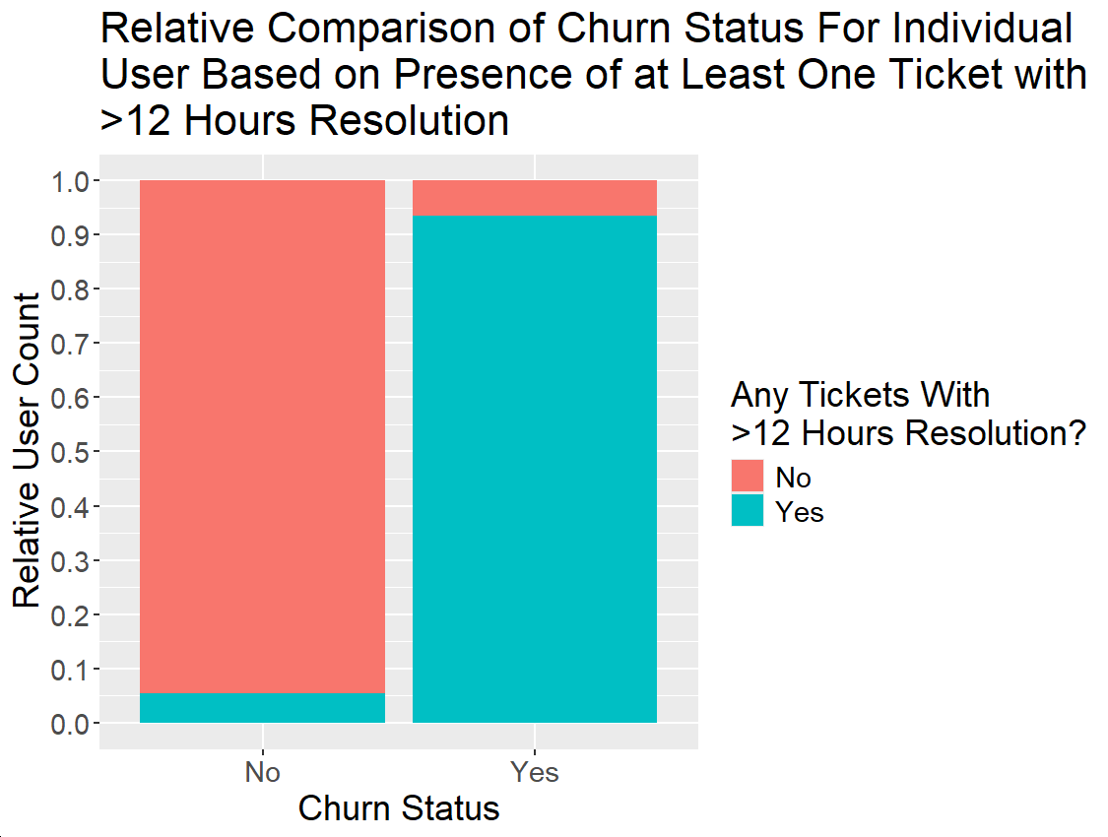
Customer Support Activity
Majority of customers who dropped their subscription have experienced at least one customer support ticket taking longer than 12 hours to solve

Slide 7
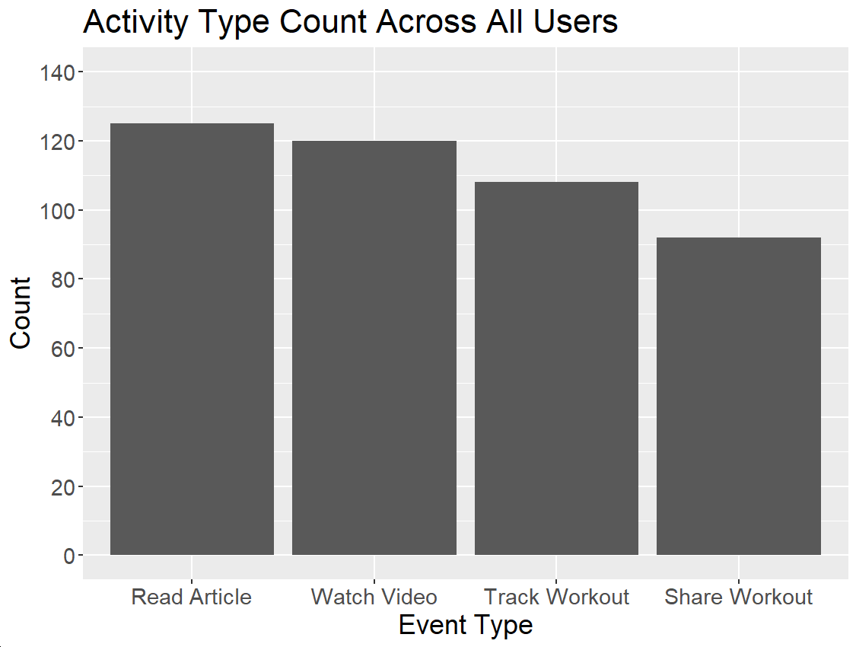
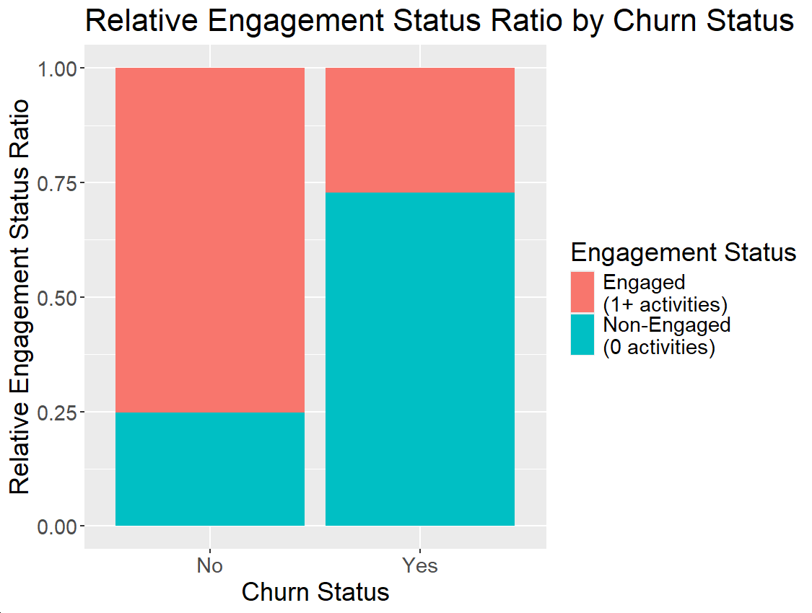
User Activity Analysis
Users are engaged in all activity options provided by our app
38.5% of all users did not engage in any activity in the past 6 months
Majority of users who canceled their subscription have not engaged in any activity

Slide 8
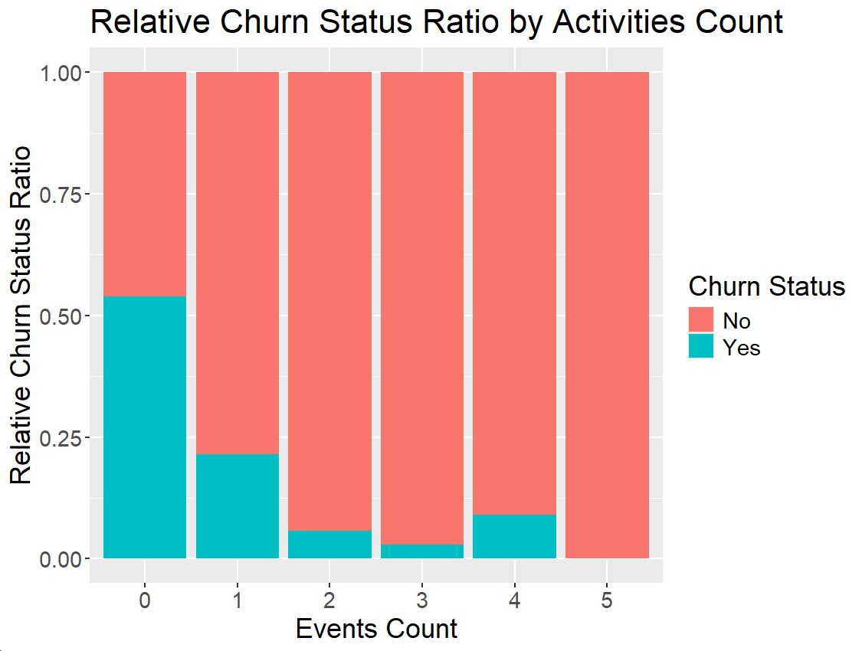
User Activity Analysis
Churn rates are highest for users not engaged in any activity in the past 6 months
Engaged users, with at least 1-2 activities every 6 months, generally maintain their subscription

Slide 9
Business Metrics
Business Focus | Business Metric | Current Value
Plan Types | Free Plan Churn Rate | 41.0%
Plan Types | Paid Plans Churn Rate | 24.1%
Customer Support | Proportion of Tickets with Resolution >12 Hrs | 27.9%
User Engagement | Proportion of Non-Engaged Users (Over 6 Months Period) | 38.5%
User Engagement | Proportion of 1+ Activity Users (Over 6 Months Period) | 61.5%
User Engagement | Proportion of 2+ Activity Users (Over 6 Months Period) | 33.5%

Slide 10
Business Recommendations
In the short-term, inform users about the different plans and features
Limited time offers to try features from different plans or upgrade
Implement priority-based customer support, with a focus on solving tickets in less than 12 hours (e.g. tickets over 8 hours should receive critical priority)
Nudge users to engage in activities, targeting specifically users with no activities in the past 3-6 months
In the long-term, survey our customers about their preference for current and new features or activities
Enrich our datasets with more information about customers in order to establish importance of factors affecting churn and address them in a data-driven manner

